Slide 1
Inside the Mind of Procurement & Purchasing
March 5, 2026
Tristan Tamez

Slide 2

Inside the Mind of Procurement & Purchasing
Content
Executive Summary
Page 3
Effective Strategies
Page 4
Ineffective Strategies
Page 5
Advice
Page 6
Key Insights
Page 7
Data
Page 8-14
Thank You Emails
Page 15-16
Appendix
Page 17

Slide 3
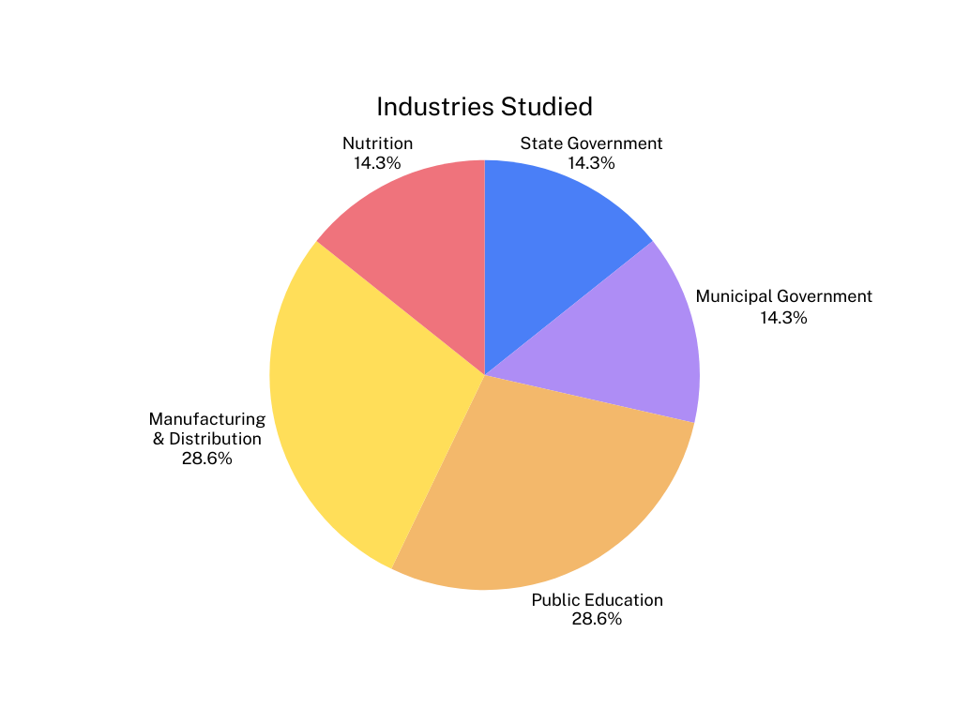
Inside the Mind of Procurement & Purchasing
Executive Summary
Tasks
Main Ideas
  Interview purchasers
  Identify effective/ ineffective sales practices
  Collect advice
  Credibility & honor
  Preperation & business knowledge
  Long term value and relationship
7 Companies Interviewed & 5 Industries Studied

Slide 4
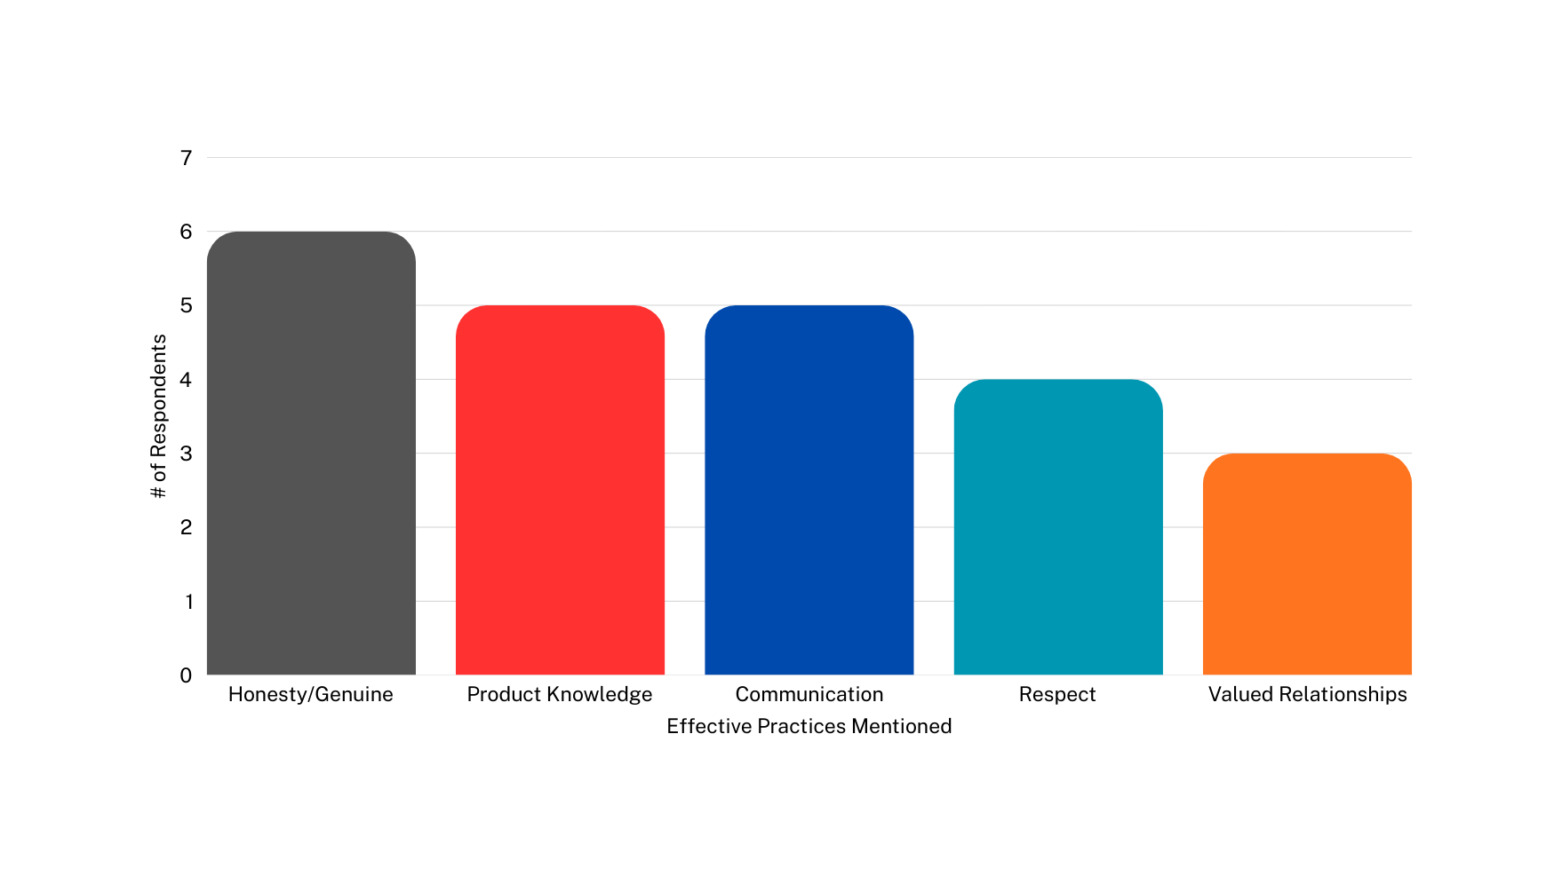
Inside the Mind of Procurement & Purchasing
Effective Practices
Transparent and genuine communication where sales professionals openly share information and admit when they do not know something.
Demonstrating a strong understanding of the product, pricing drivers, and operational impact.
Providing concise, timely, and well documented communication with buyers.
Following purchasing protocols such as purchase orders and vendor approval processes.
Focusing on long term value and partnership rather than transactional selling.

Slide 5
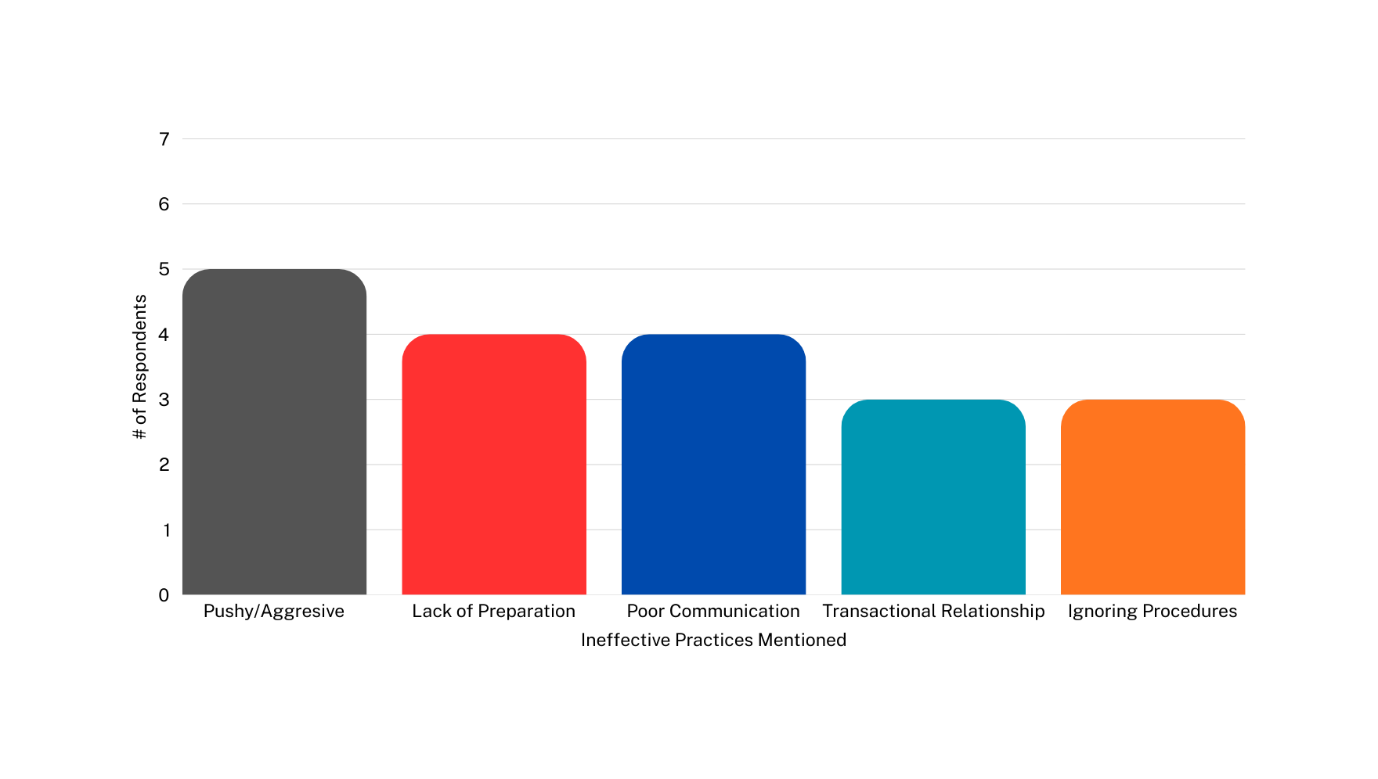
Inside the Mind of Procurement & Purchasing
Ineffective Practices
Applying excessive pressure through repeated calls, emails, or unannounced visits that disregard the buyer’s time and decision process.
Entering sales conversations without a clear understanding of
the product,
pricing drivers, or operational factors that influence purchasing decisions.
Providing unclear information, delayed responses, or failing to communicate issues early enough for buyers to plan.
Focusing on closing an immediate deal rather than understanding the customer’s long term needs.
Attempting to bypass established purchasing protocols such as purchase orders, or vendor approvals

Slide 6
Inside the Mind of Procurement & Purchasing
Advice
Develop Deep Product & Business
Knowledge
Be Honest & Authentic
Respect the
Buyer’s Time & Processes
Focus on Long Term Value, Not Just the Sale
Mentioned By: Oliver, Meredith, Jeanette, Eugene
Mentioned By: Kerby, Michael, Jeanette, Oliver
Mentioned By: Meredith, Lauren, Oliver
Mentioned By: Eugene, Michael

Slide 7
See Page 17 for full defintion/application
Inside the Mind of Procurement & Purchasing
Purchasing Insights
Mastering Complex Sale
Prioritizes Risk Reduction
Decison Criteria
Intelligence Builds Credibility
Value Hypothesis
Focus on Long Term Value
Trusted Advisor

Slide 8
Eugene Galdi- Chief Procurement Officer
Meeting Information:
(832) 289- 3316- eugenegaldi@gmail.com
February 27, 2026 - 1:00 PM
Effective
Practices
Ineffective
Practices
Advice
Given
  Understand the customer’s supply chain and cost drivers
  Focus on total cost of ownership, not just price
  Share market intelligence and industry insights
  Communicate risks early and avoid surprises
  Focusing only on unit price without understanding the business
  Ignoring logistics, lead times, and reliability risks
  Treating procurement as an obstacle rather than a partner
  Failing to communicate market insights internally
  Become a commercially intelligent business partner
  Understand finance, cost structures, and how the customer makes money
  Share customer insights internally to improve competitiveness
  Work cross functionally between sales, procurement, and operations
Example:
Example:
  A supplier shared global demand data for a raw material, helping the company anticipate shortages and plan purchasing decisions.
  A supplier once offered the lowest price but had unreliable delivery, causing production disruptions that eliminated the cost savings.

Slide 9
Oliver Mueller - Procurement Coordinator for the city of Boerne
Meeting Information:
(830) 248-1545 - omueller@ci.boerne.tx.us
March 2, 2026 - 3:30 PM
Effective
Practices
Ineffective
Practices
Advice
Given
  Provide clear quotes with numbers
  Maintain strong communication / follow up promptly
  Demonstrate strong product knowledge & preparation
  Be genuine & trustworthy
  Providing vague information or incomplete pricing details
  Relying on phone calls instead of written communication
  Showing limited understanding of the product being sold
  Know your product thoroughly before engaging with buyers
  Be honest when you do not have an answer
  Maintain professional and consistent communication throughout the purchasing process
Example:
Example:
  Submitting quote requests through official websits with clear pricing and documentation helps procurement teams review vendors efficiently
  Many vendors fail to respond to online quote requests, which slows the purchasing process and makes the sales interaction less effective

Slide 10
Lauren Terrazas - Southwest ISD Procurement Clerk
Meeting Information:
(210) 622-4746 - LTerrazas8419@swisd.net
March 2, 2026 - 5:30 PM
Effective
Practices
Ineffective
Practices
Advice
Given
  Be transparent and accountable
  Maintain accurate records and ensure orders are properly closed out and paid
  Respect procurement procedures
  Approach the relationship as a partnership
  Attempting to fulfill orders without an approved purchase order
  Ignoring established procurement procedures
  Approaching procurement only with the goal of making a quick sale
  Avoid being pushy with procurement professionals and respect the structured purchasing process
Example:
Example:
  Vendors who follow procedures and ensure orders are documented/ closed correctly help procurement teams maintain accurate records
  When vendors try to fulfill an order without a purchase order, it creates compliance problems because auditors may view the purchase as unauthorized

Slide 11
Kerby Orton - Purchaser II for Texas House of Representatives
Meeting Information:
(512) 463-8151 - kerbyorton@gmail.com
February 27, 2026 - 2:30 PM
Effective
Practices
Ineffective
Practices
Advice
Given
  Work through pre approved vendor systems
  Provide competitive pricing and clear quotes
  Meet delivery timelines and expectations
  Attempting to sell outside the approved vendor process
  Offering non competitive pricing
  Failing to meet delivery expectations
  Be genuine and authentic when working with procurement professionals
Example:
Example:
  Competitive pricing through the approved vendor system is easier for procurement to evaluate and approve
  If a salesperson tries to bypass the approved vendor system and sell directly to a department, procurement cannot move forward with the purchase

Slide 12
Meredith Rokas- Director of Purchasing for nutrition East Central ISD
Meeting Information:
(210) 634-6143 - meredith.rokas@ecisd.net
March 2, 2026 - 4:30 PM
Effective
Practices
Ineffective
Practices
Advice
Given
  Know your product details, pricing, and approval parameters
  Be respectful of procurement professionals’ time
  Show genuine interest in helping the organization rather than just making a sale
  Spam calling or sending repeated solicitation emails
  Showing up unannounced or being overly aggressive
  Making it obvious that the interaction is driven by commission
  Proofread emails carefully and communicate professionally when reaching out to procurement
Example:
Example:
  Vendors who clearly understand their product and communicate concise information allow teams to evaluate purchases quickly and efficiently
  Rokas noted that with over 600 emails received weekly, sales emails that appear generic or spam like are often ignored or deleted immediately

Slide 13
Michael Brymer - Procurement Clerk at Jet Specialty
Meeting Information:
(361) 299-1711 - michael.brymer@jetspecialty.com
February 27, 2026 - 3:30 PM
Effective
Practices
Ineffective
Practices
Advice
Given
  Be upfront and honest in all communication
  Maintain professionalism rather than being overly friendly
  Be open to new ideas and solutions
  Being overly casual or overly friendly in professional settings
  Misleading buyers or failing to communicate issues honestly
  Work hard, stay organized, and manage your time effectively while continuing to learn from every interaction
Example:
Example:
  Vendors who communicate honestly about pricing, availability, or mistakes build stronger trust and long term relationships with procurement teams
  When salespeople try too hard to be friendly or hide problems, it often damages credibility with procurement professionals

Slide 14
Jeanette French- South San ISD Procurement Specialist
Meeting Information:
(210) 977-7025 - jeanette.french@southsanisd.net
March 3, 2026 - 3:00 PM
Effective
Practices
Ineffective
Practices
Advice
Given
  Research the organization and understand the buyer’s role/history
  Show genuine respect and professionalism
  Failing to research the organization before reaching out
  Offering pricing that is inconsistent or not competitive
  Appearing focused only on profit rather than supporting the school’s needs
  Be kind, genuine, and respectful while taking time to understand the organization you are working with.
Example:
Example:
  Vendors who understand how school districts operate and provide competitive pricing are more likely to be considered, especially when budgets rely heavily on local funds and grants.
  Vendors who refuse to offer reasonable pricing despite understanding school budget limitations are often viewed negatively and lose opportunities.

Slide 15
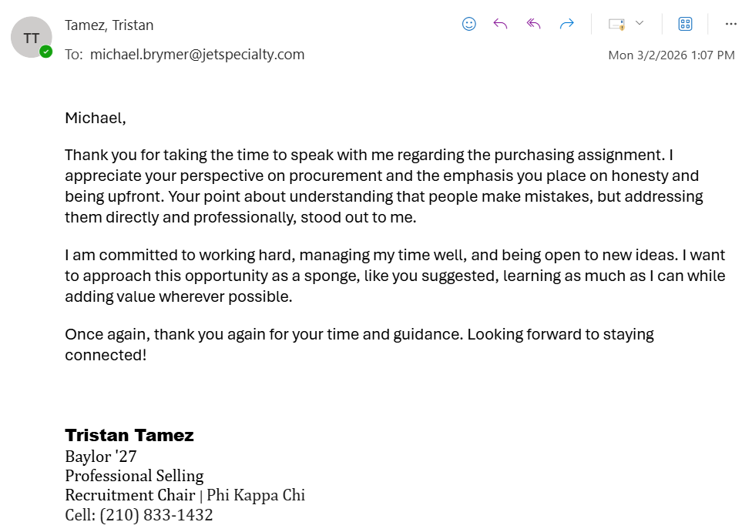
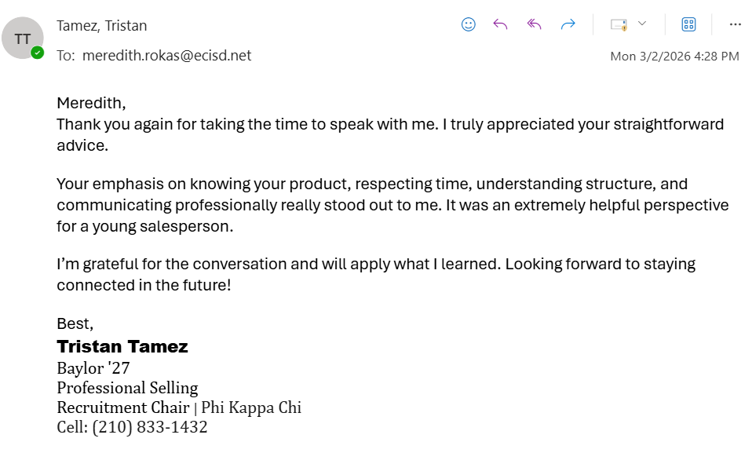
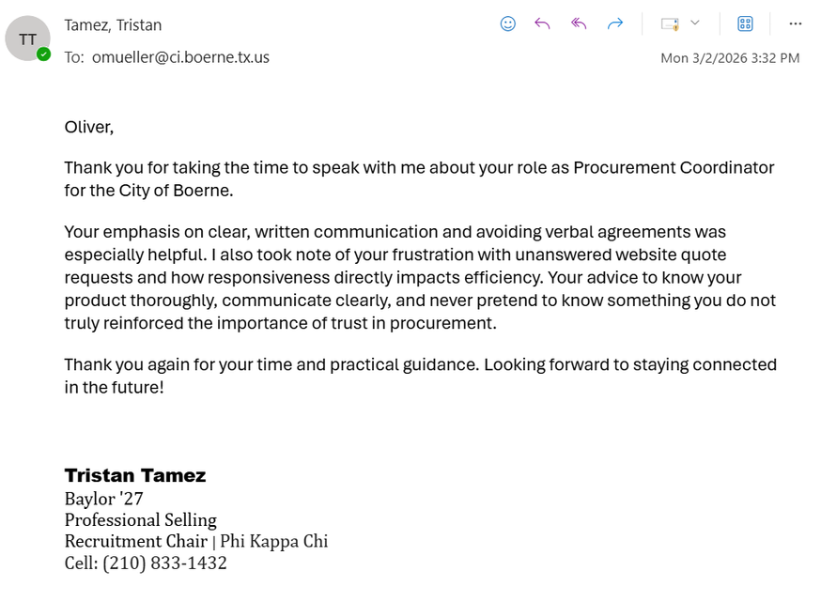
Thank You Emails
Inside the Mind of Procurement & Purchasing

Slide 16
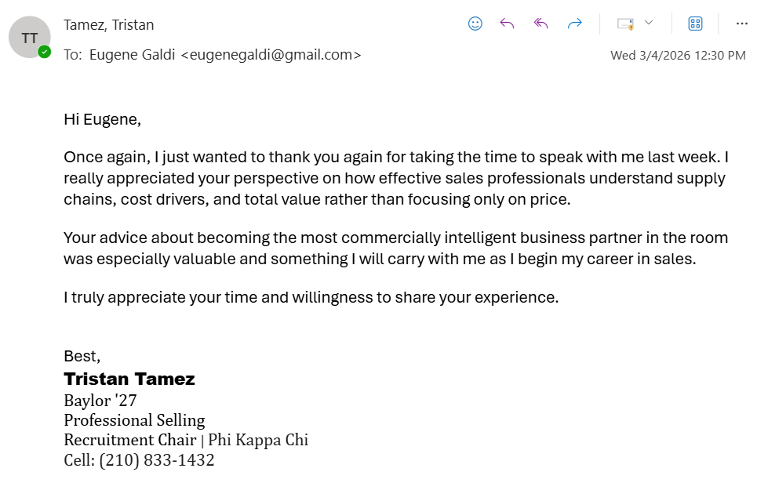
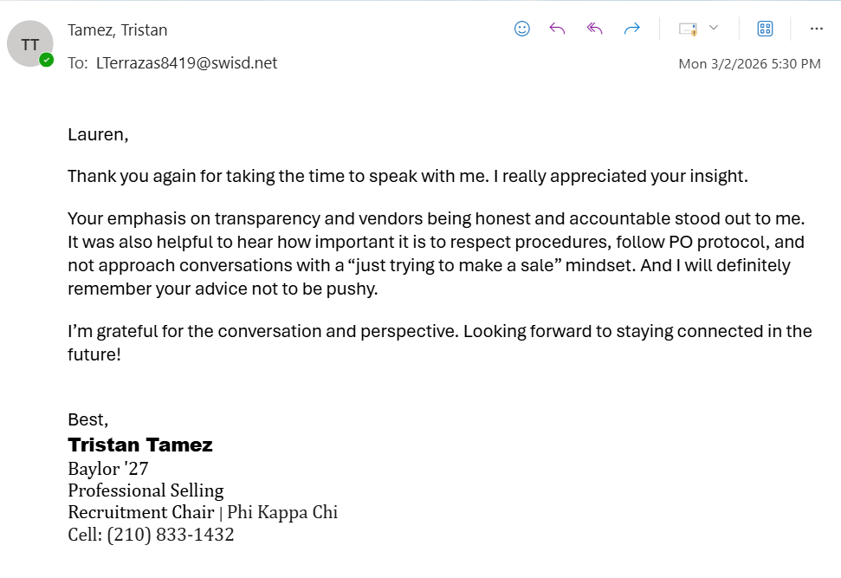
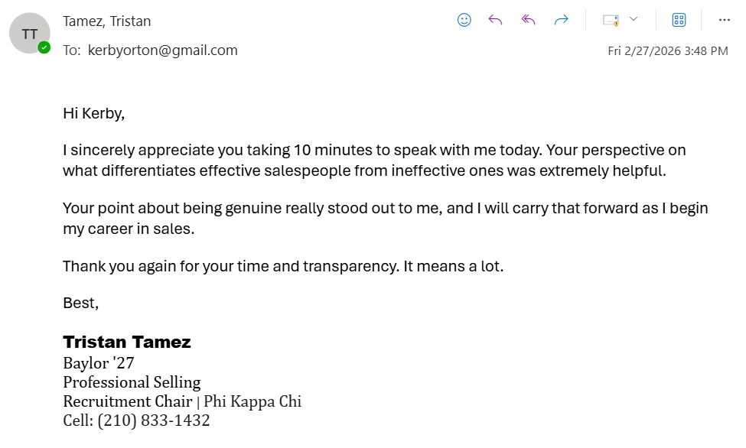
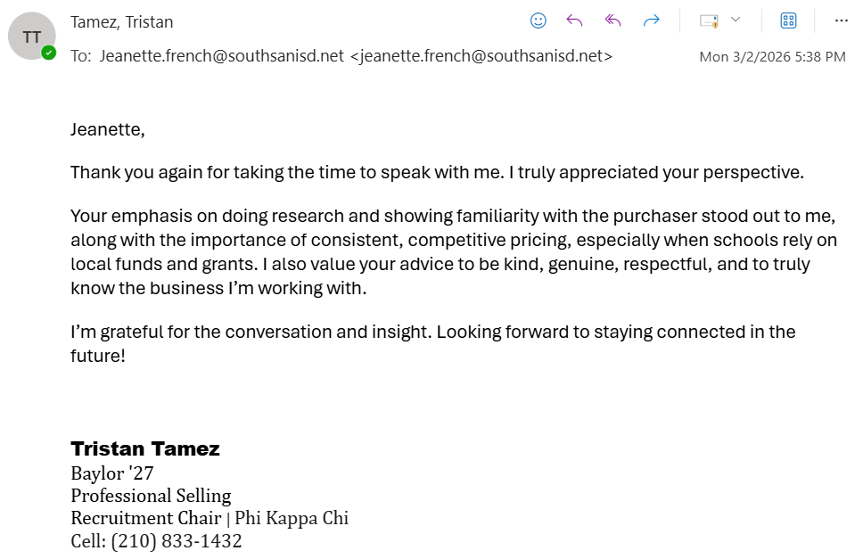
Thank You Emails
Inside the Mind of Procurement & Purchasing

Slide 17
Inside the Mind of Procurement & Purchasing
Key Insights
Mastering Complex Sale
Prioritizes Risk Reduction
Decison Criteria
Procurement prioritizes reliability, transparency, and compliance to reduce operational and financial risk.
Decision criteria are the standards buyers use to evaluate solutions; procurement’s focus on reliability, transparency, and compliance reflects these risk reducing priorities.
Intelligence Builds Credibility
Value Hypothesis
Salespeople who understand supply chains, cost drivers, and the customer’s business build greater credibility.
A value hypothesis connects a solution to measurable business outcomes; salespeople who understand supply chains and cost drivers can position their offering around operational value.
Focus on Long Term Value
Trusted Advisor
Buyers prefer partners who focus on long term value rather than short term transactional wins.
A trusted advisor is a salesperson viewed as a strategic partner; focusing on long term value rather than short term transactions builds credibility with procurement professionals.

